Slide 1

A Lightweight Health Risk Analysis App for the Elderly using SleepStudies
Guided by,
Geetha Lekshmi V .
Anuvind MP (AM.EN.U4AIE22010)
R S Harish Kumar (AM.EN.U4CSE22042)

Slide 2
Outline
Introduction
Problem Definition
Objectives
Literature Review Summary(Table)
Research Gap
Dataset Description
Methodology / Proposed Method
Design/ Architecture
Algorithms (if any)
Evaluation Metrics
Result Analysis
Limitations
Phase II plan
Reference(APA style)
Project title

Slide 3
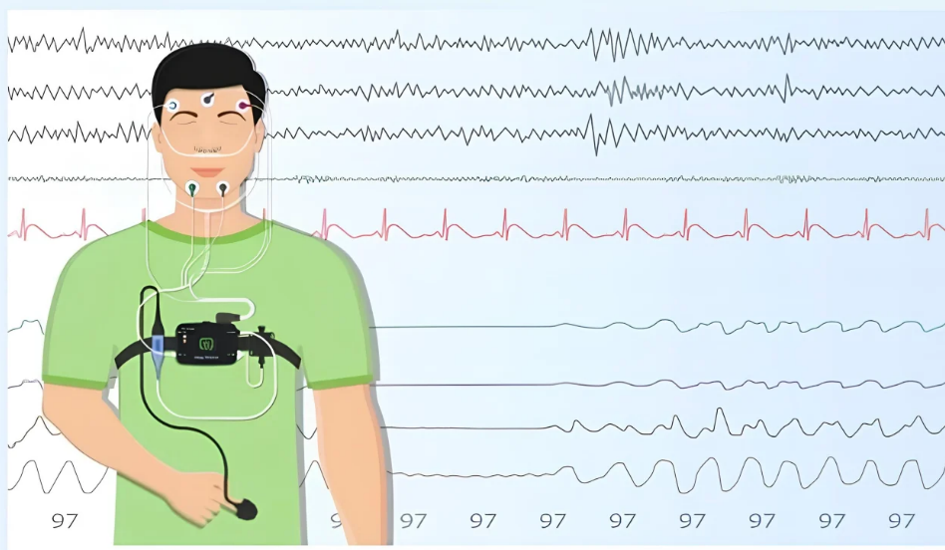
Introduction
Aging populations face increasing chronic disease burdens.
Early detection through sleep analysis facilitates timely interventions.
Increasing healthcare costs and morbidity.
Polysomnography (PSG) provides rich multi-modal signals that capture these sleep-related physiological changes.
This can significantly reduce healthcare costs and improve quality of life for aging adults.
Notes:
Cite the work that detects dementia, Parkinson’s using polysomnography data..
Early detection through sleep analysis facilitates timely interventions – of cardiovascular disease. Dementia ,Parkinson’s???
Introduction should align with disease risk prediction, which are the systems currently using polysomnograpy data and what are the limitations?
Corrections/Modifications
Problem with sleep in elderly?? Statistics
Relation of sleep with cardio vascular disease, any info from papers??give ref also

Slide 4
Problem Definition
Manual PSG analysis is time-consuming, expensive, and inaccessible in resource-limited regions, limiting early health risk detection for elderly populations.
Existing AI models for PSG analysis are computationally heavy and unsuitable for deployment on low-end devices, preventing practical implementation where it's needed most.
There is a need for a lightweight, efficient framework that can reliably assess cardiac, respiratory, and mental health risks while remaining deployable in constrained healthcare environments.
Project title

Slide 5
Objectives
Generate an lightweight architecture to deploy on low-end systems and to promote green AI.
Generalize the population representation by harmonizing multiple datasets from different cohorts.
Provide risk profiles for under represented ailments such as mental disorders which has a negative perception or social stigma for diagnosing in the Indian community.
Experimentation between various search strategies for NAS such as DARTS, RL, Genetic/Hierarchical, Random search.
Project title

Slide 6
Literature Review Summary (Table)

Slide 7
Research Gap

Slide 8
Dataset Description
Multiple publicly available PSG datasets were surveyed, including Cleveland Family Study (CFS), Wisconsin Sleep Cohort (WSC), MrOS Sleep Study (MROS), Sleep Heart Health Study (SHHS) and Multi-Ethnic Study of Atherosclerosis (MESA), to capture diverse populations and acquisition protocols.​
A common multimodal PSG representation was defined by identifying seven channels consistently available across these datasets: EEG, EOG, ECG, EMG, leg movement, thoracic movement, and SpO₂, ensuring cross-dataset compatibility.​
The current phase focuses on the Cleveland Family Study (CFS) dataset, using its PSG recordings and clinical labels to build cardiac, respiratory, and mental health risk cohorts.

Slide 9
Methodology

Slide 10
Design

Slide 11
Algorithm

Slide 12
Methodology

Slide 13
Evaluation Metrics

Slide 14
Result Analysis

Slide 15
Limitations

